Slide 1
FUNDAMENTALS
Team 1
ANIKET GIDVIR
NIKITA SINGHAL
RAVALI. P
SHRIYA GANEKAR
SWAYANSIDHA GANTAYAT
TASMIA SHAFI

Slide 2
CONTENTS
Hardware
Windows Fundamentals
Linux Fundamentals
Network Fundamentals
Network Services
Database Fundamentals
Application
Storage Fundamentals
Linux Essentials
Windows Essentials
Cisco routing
Virtualization

Slide 3
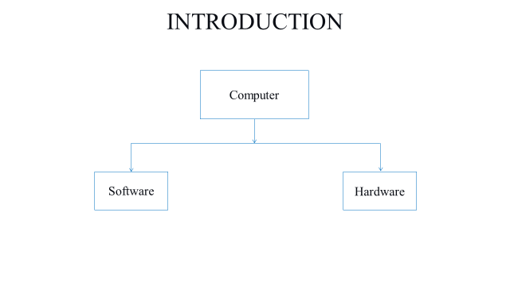
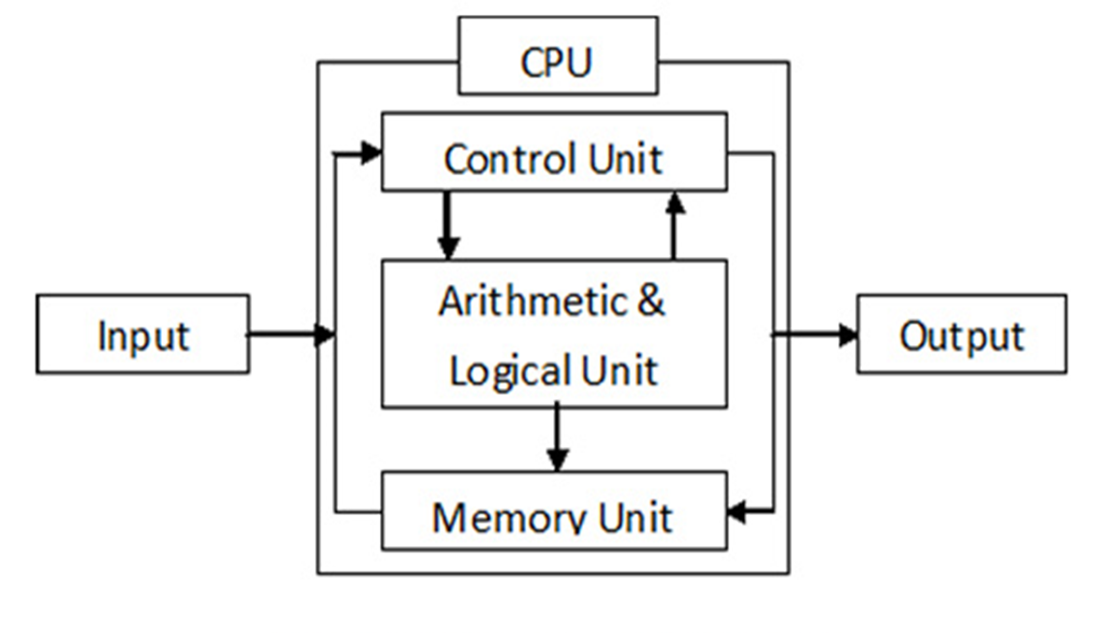
INTRODUCTION
Block Diagram Of Computer

Slide 4
HARDWARE

Slide 5
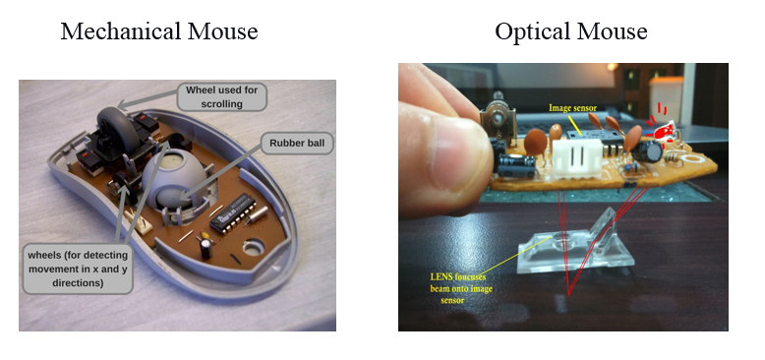
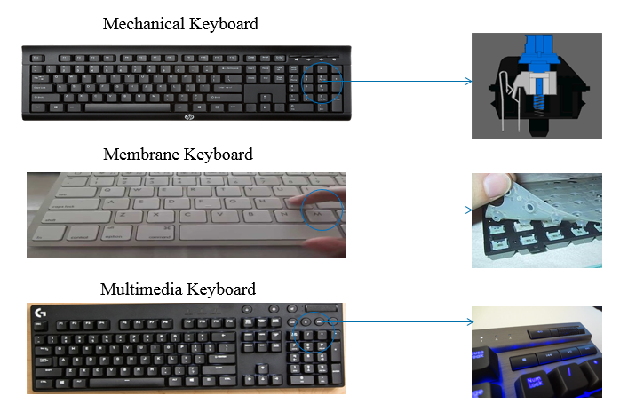
INPUT DEVICES
MOUSE
KEYBOARD

Slide 6
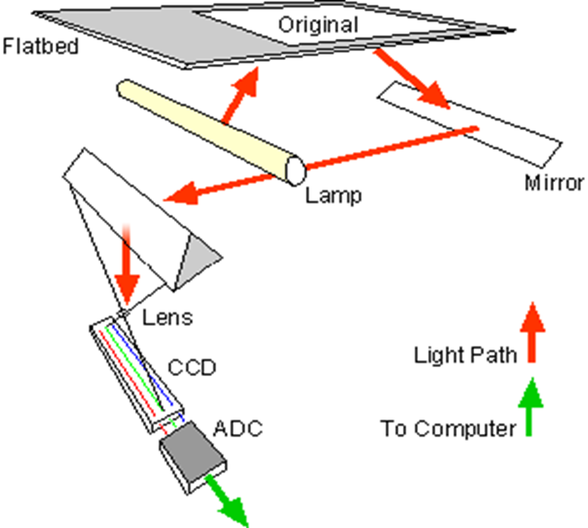
SCANNER

Slide 7
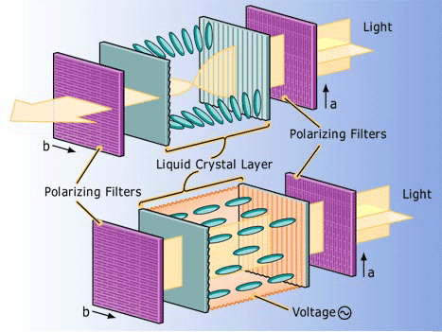
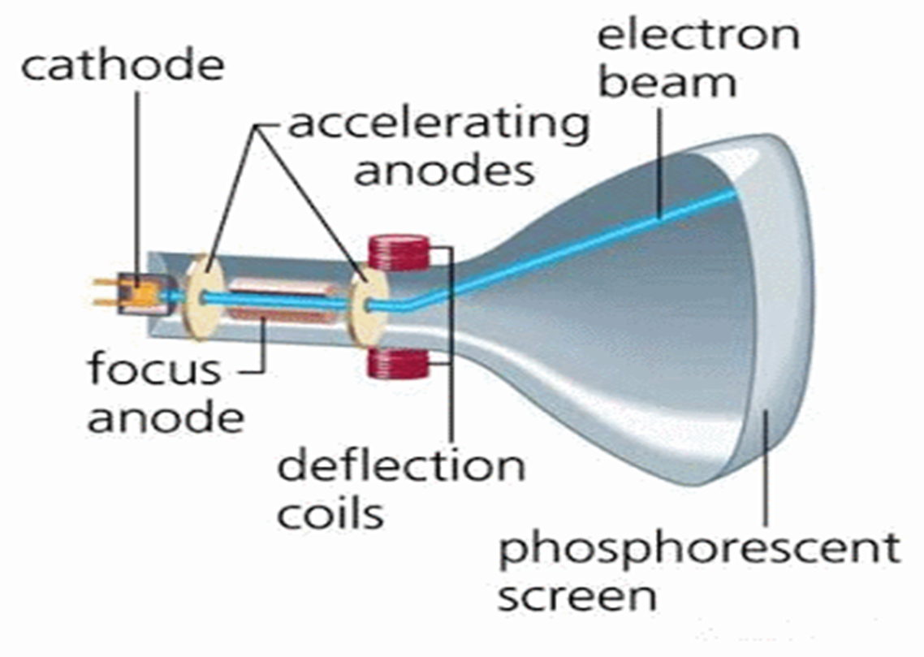


OUTPUT DEVICES
CRT Monitor
(Cathode ray tube)
LCD Monitor
(Liquid crystal display)

Slide 8

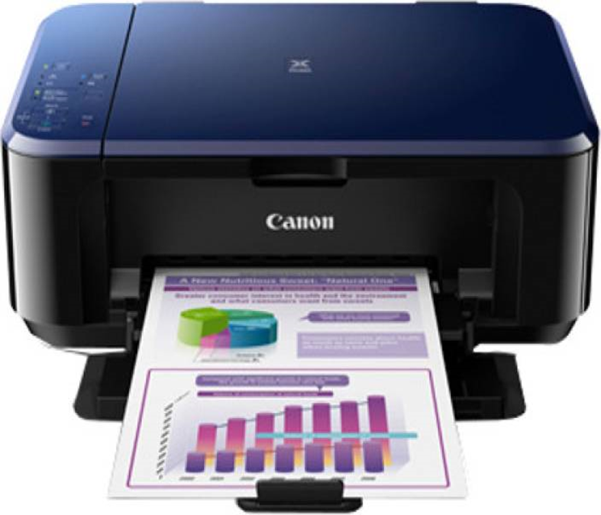
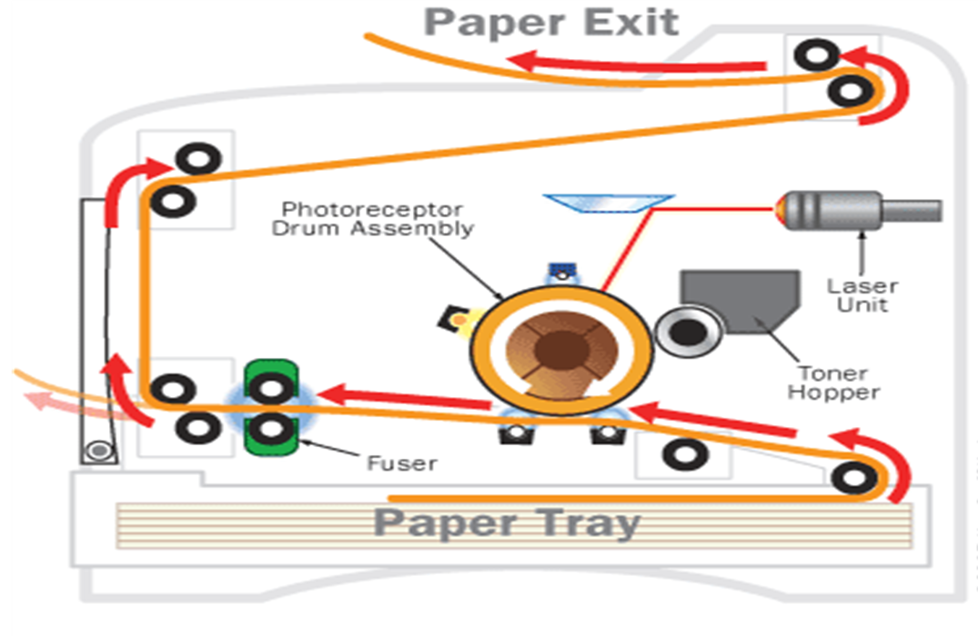
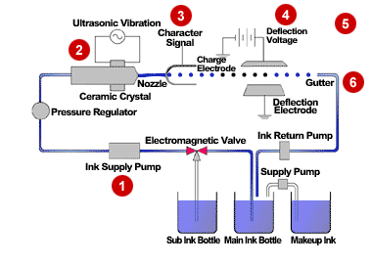
Laser printer
Ink jet Printer

Slide 9
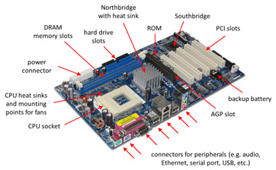
MOTHERBOARD

Slide 10
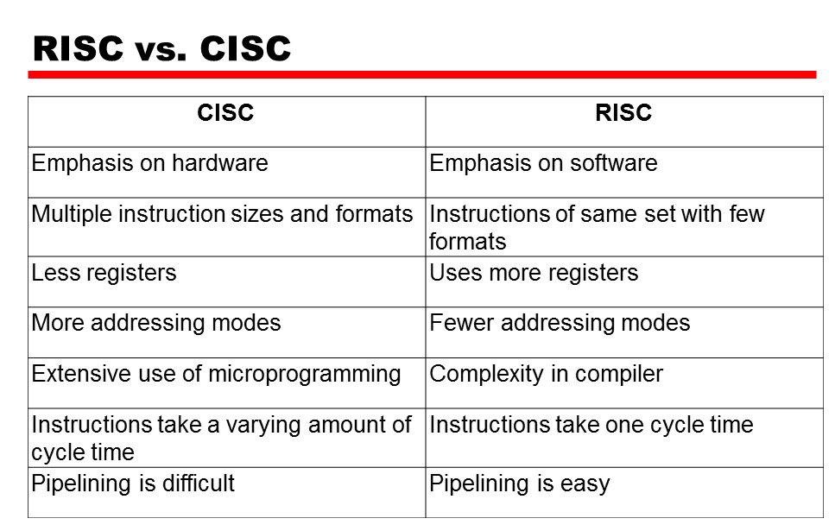
CPU

Slide 11
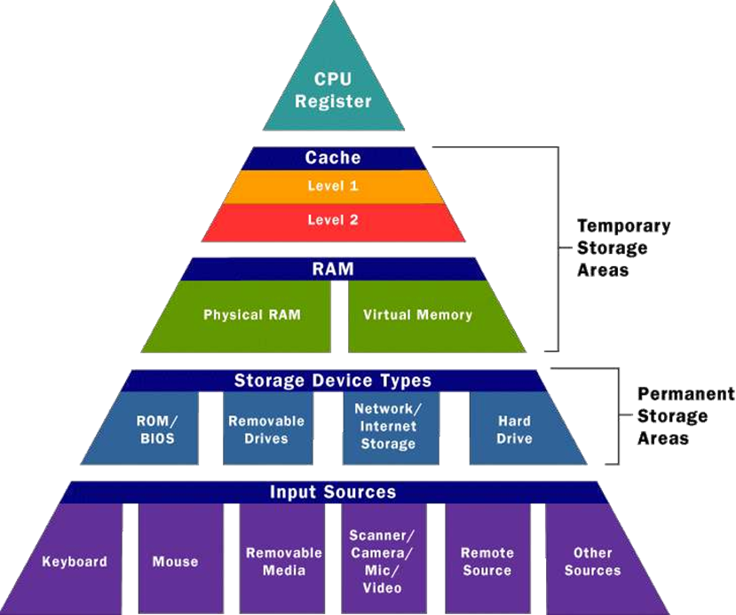
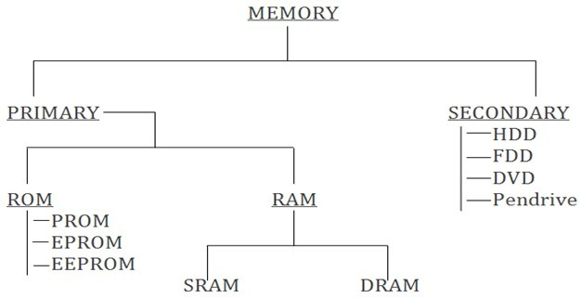
MEMORY

Slide 12
WINDOWS FUNDAMENTALS

Slide 13
INTRODUCTION TO OPERATING SYSTEM
Types of OS:
Batch operating system
Time-sharing operating systems
Distributed operating System
Network operating System
Real Time operating System
Types of Kernel:
Monolithic Kernel
Microkernel
Hybrid Kernel

Slide 14
WINDOWS KERNEL
Logon Process
Win 32 application
Local security authority
Security Accounts Manager
Win 32 Subsystem
User Mode
-------------------------------------------------------------------------------------------------------------------------------------------------
Kernel Mode
I/O Manager
Power manager
Plug and play manager
EXECUTIVE SERVICES
Local procedural call
Kernel transaction Manager
Object manager
Process and Thread Manager
Memory manager
Security Reference monitor
Configuration Manager (Registry)
Cache Manager
File System Driver
Network drivers
Device Drivers
Window manager
GDI
Graphics Device Drivers
Kernel
Hardware Abstraction Layer
Hardware

Slide 15
WINDOWS BOOTING
MBR
Boot sector
Boot manager (bootmgr)
Boot Loader (winload.exe)
Loads Kernel
BIOS
BCD
Phase 0
Processor
Phase 1
SMPS
Session manager sub system smss.exe
csrss.exe
Explorer Initialization
Session 0
Session 1

Slide 16
WINDOWS FILE SYSTEM
File Allocation Table (FAT)
New Technology File System (NTFS)
Boot
Sector
FAT
Copy
Files and
Folders
Boot
Sector
Master
File
Table
Files and
Folders
MFT
Copy
FAT

Slide 17
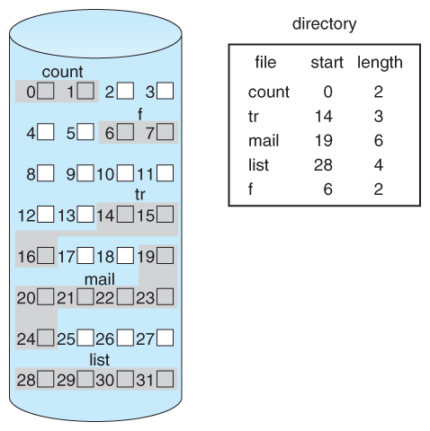
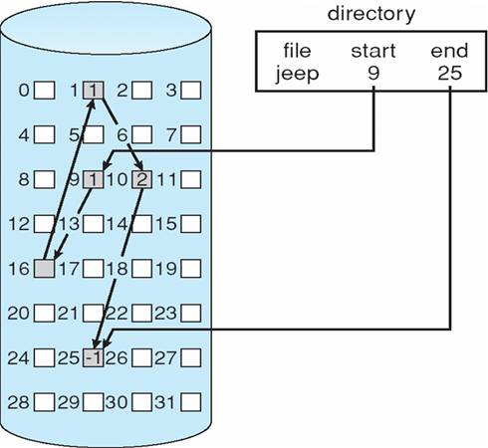
FILE ALLOCATION MECHANISM
Contiguous Allocation
Linked Allocation

Slide 18
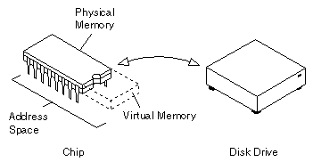
MEMORY MANAGEMENT
Virtual Memory
A computer can address more memory than the amount physically installed on the system. This extra memory is actually called virtual memory and it is a section of a hard disk that's set up to emulate the computer's RAM.
Functions of Virtual Memory
Allows us to extend the use of physical memory by using disk.
Allows us to have memory protection

Slide 19
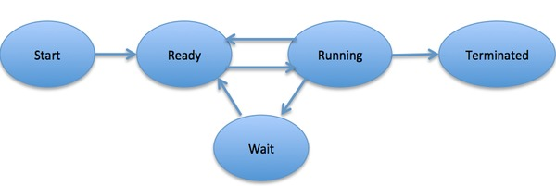
WINDOWS PROCESS MANAGEMENT
Process: Process is an instance of a computer program that is being executed.
Processing Types:
Multiprocessing
Multithreading
Hyperthreading
Multitasking

Slide 20
LINUX
FUNDAMENTALS

Slide 21


LINUX
History of Linux
Invented by Linus Torvalds in the year 1991.
Linux was started as a fun but ended up with such a large project.
Today, supercomputers, smart phones, desktop, web servers, tablet, laptops and home appliances use Linux OS.
Advantages
Security is the main advantage.
Many programmers have contributed and added software that’s completely open-source for any user.
Linux being an open-source, there is a wide variety of classification.

Slide 22

LINUX SUBSYSTEMS
Word
PPT
Web Browser
User Applications
Function Calls
Shell
x11
OS Services
System Calls
Memory Manager
Process Scheduler
VFS
Network Interface
IPC
Linux Kernel
Interrupts
HDD
Printer
Mouse
Keyboard
Hardware Controllers

Slide 23
KERNEL
Memory Manager
Virtual File System
Process Scheduler
Inter-process communication
Network Interface
Monolithic Kernel

Slide 24
LINUX BOOTING
Power on
Process boot time menu
GRUB loads kernel image
& initial RAM disk
BIOS
Load stage 1 GRUB
from MBR
Kernel mount root file system
Load stage 1.5 then
stage 2 of GRUB
Kernel runs init
init runs script to start
user level services
GRUB reads menu.lst

Slide 25
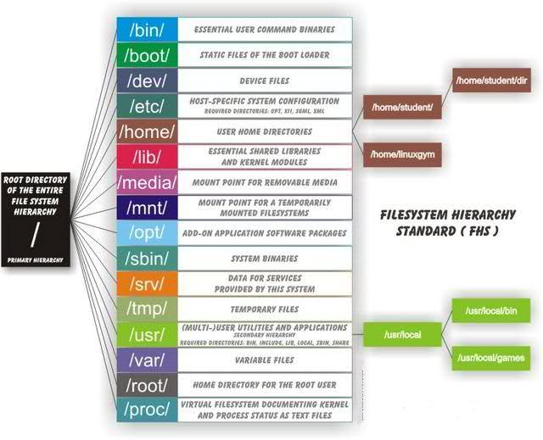
LINUX RUNLEVELS AND DIRECTORIES
Run levels | Mode
0 | Shut down the system
1 | Single user mode
2 | Basic multiuser mode without NFS
3 | Full multiuser mode (Text based)
4 | Un used
5 | Multiuser mode with GUI
6 | Reboot system

Slide 26
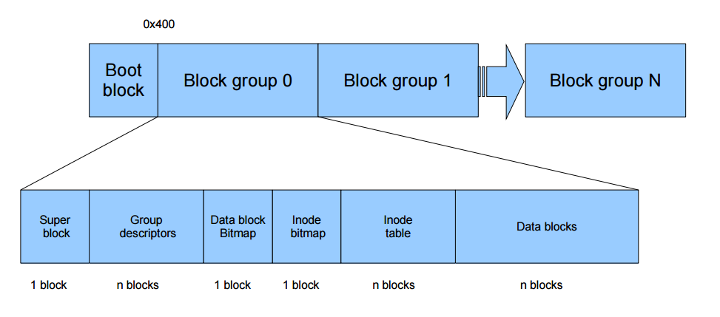
LINUX FILE SYSTEM
Ext2 – Second Extended File System
Maximum file size is 16GB – 2TB.
Journaling feature is not available.
Ext3 – Third Extended File System
Max file size 16GB – 2TB.
Provide facility to upgrade from Ext2 to Ext3 file systems without having to back up and restore data.
Ext4 – Fourth Extended File System
Max file size 16GB to 16TB.
Ext4 file system have option to Turn Off journaling feature.

Slide 27
LINUX PROCESS MANAGEMENT
Process: A process is an instance of a computer program that is being executed.
Types
Automated
Zombie
Parent
Child
Daemon
Interactive
Orphan
Inter-Process Management: IPC is a technique to exchange of data among multiple threads in one or more processes.
Signals
Message Queues
Pipe
Semaphore
Shared Memory

Slide 28
NETWORK FUNDAMENTALS

Slide 29
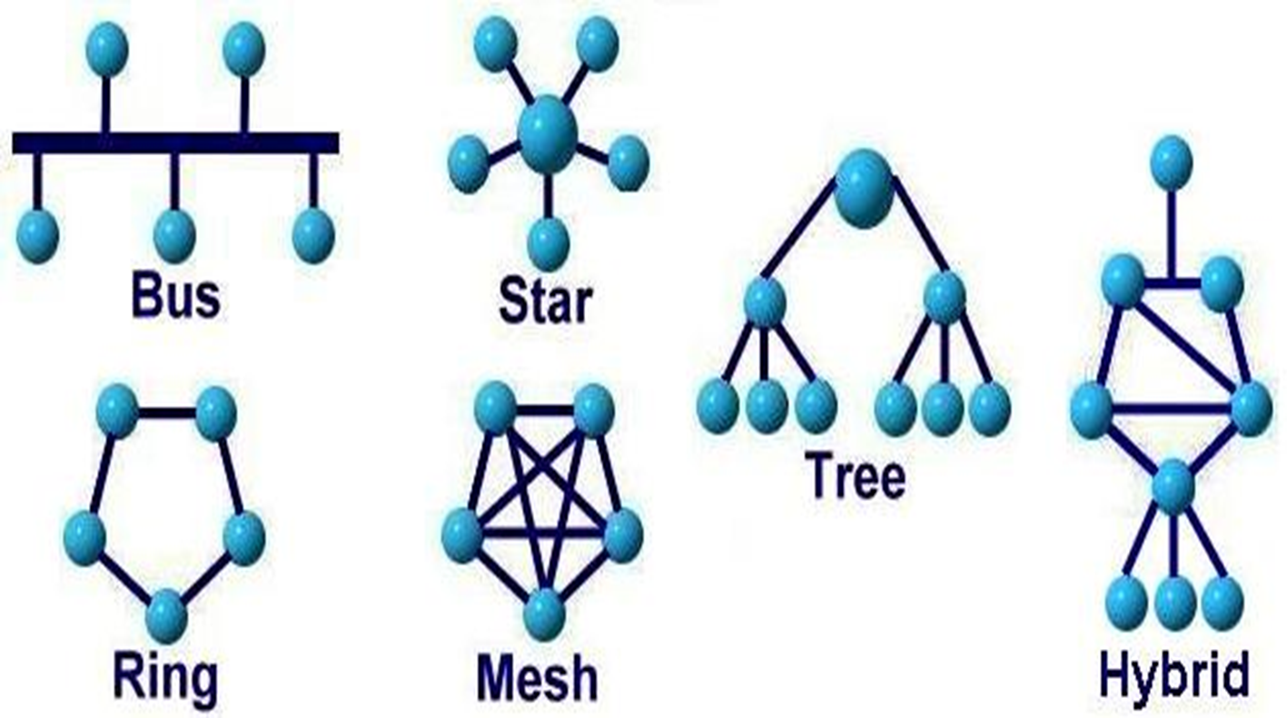
NETWORK
Characteristics of Network
Types of communication
Fault tolerance
Scalability
Quality of service
Security
Simplex
Half Duplex
Full Duplex
Network topologies

Slide 30
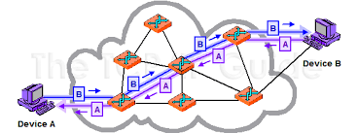
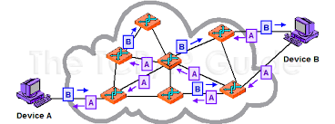
NETWORK TYPES
WAN
MAN
LAN
Circuit Switching
Packet switching

Slide 31
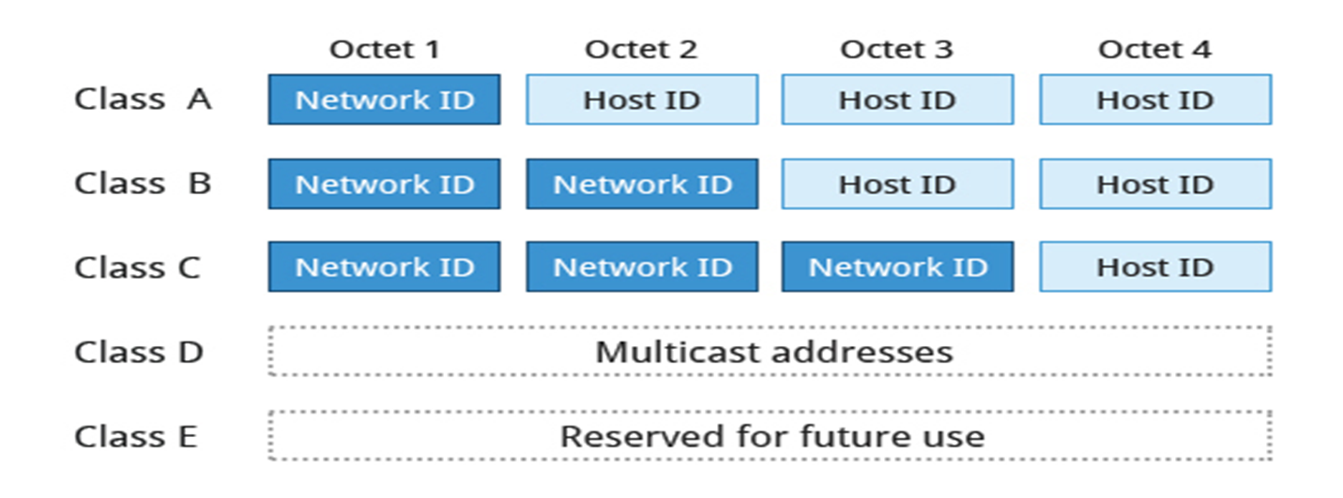
NETWORK DEVICES
IP ADDRESS
IPV4, IPV6
Types- Network Address
Broadcast Address
Host Address
Subnet Mask
Router
Switch
Bridge
Hub
Repeater

Slide 32
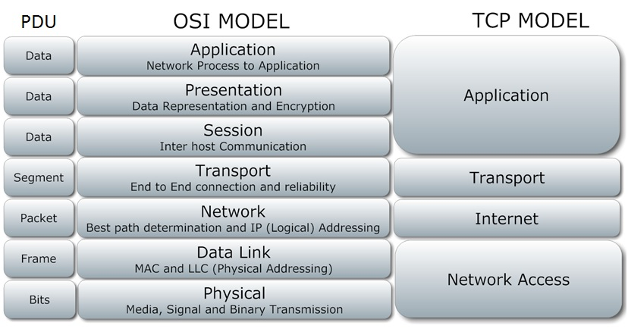
OSI AND TCP MODEL

Slide 33
APPLICATION LAYER
FTP [21 for server, 20 for client]
TFTP [69]
HTTP [80] and HTTPS[443]
Telnet [23]
SMTP [25]
SNMP [161 for client,162 for server]
PRESENTATION LAYER
Encoding-Decoding
Encryption-Decryption
Compression-Decompression
Examples:
ASCII
JPEG
Notes:
A cor AZUL sempre tem que aparecer no slide. Seja nas formas ou no texto.
Uma imagem como essa nao funciona. Muito “Barbie” para uma consultoria. Eles gostam deste layout mas deveria estar separador de capitulos com o logo de “espadas” maior. Para toda insercao de imagem o fundo deve ser cinza claro.

Slide 34
SESSION LAYER
Provides the mechanism for opening, closing and managing a session between end-user application processes.
Communication sessions consist of requests and responses that occur between applications.
Synchronization is provided by the session layer.
TRANSPORT LAYER
NETWORK LAYER
Multiplexing and de-multiplexing
Segmentation
Sequencing and Reassembling
Flow control
Error detection and correction
Encapsulation and Decapsulation
Connection control
Routing
Addressing
Packetizing

Slide 35
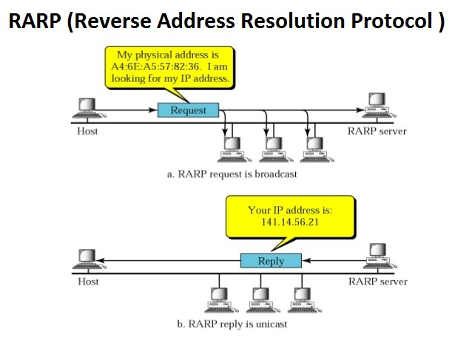
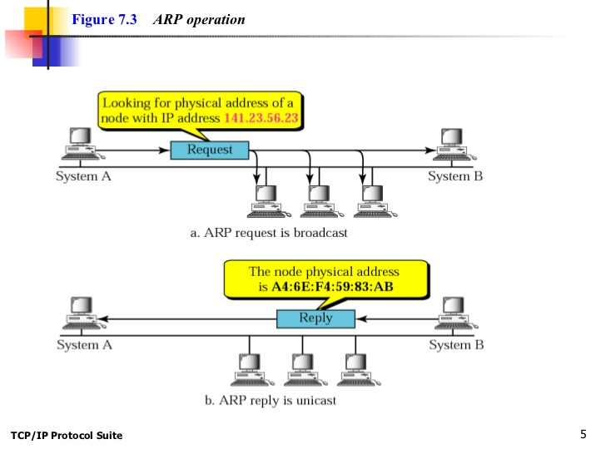
ARP(Address Resolution Protocol)
RARP(Reverse Address Resolution Protocol)
Notes:
A cor AZUL sempre tem que aparecer no slide. Seja nas formas ou no texto.
Uma imagem como essa nao funciona. Muito “Barbie” para uma consultoria. Eles gostam deste layout mas deveria estar separador de capitulos com o logo de “espadas” maior. Para toda insercao de imagem o fundo deve ser cinza claro.

Slide 36
DATA LINK LAYER
FUNCTIONS OF DATA LINK LAYER:
Framing
Physical Addressing
Flow, Error and Access Control
PROTOCOLS USED:
PPP- Point to Point Protocol
HDLC - High Level Data Link Control
Frame Relay
PHYSICAL LAYER
The physical layer defines the transmission interface between devices and transmission medium.
It defines the direction of transmission between two devices: Simplex, Half Duplex, Full Duplex.
It performs:
- Data Encoding and Data Decoding.
- Modulation

Slide 37
NETWORK
SERVICES

Slide 38
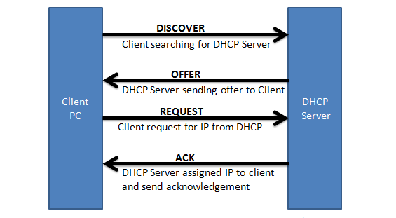
DHCP
Types of allocation of IP address :
Manual Allocation
Automatic Allocation
Dynamic Allocation

Slide 39
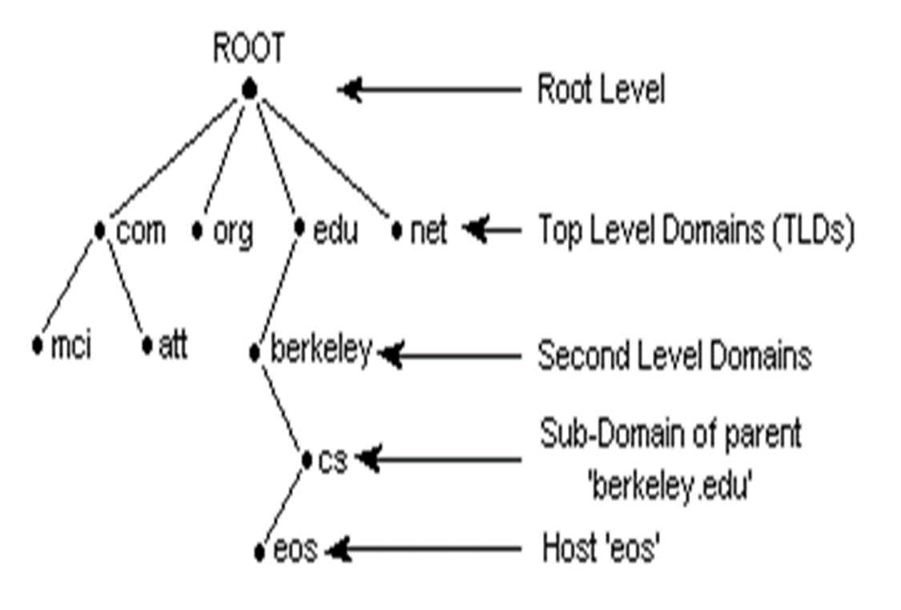
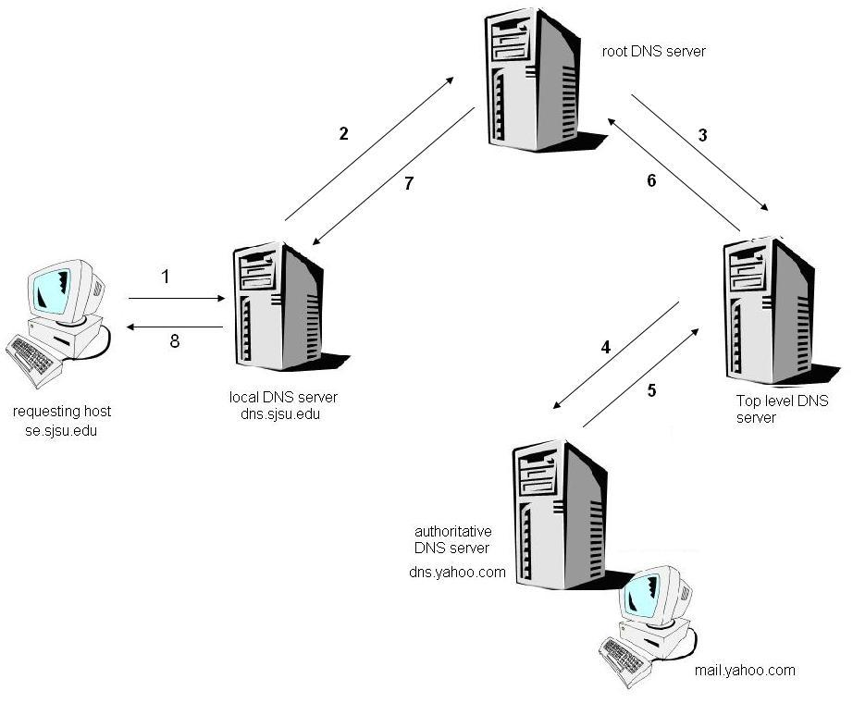
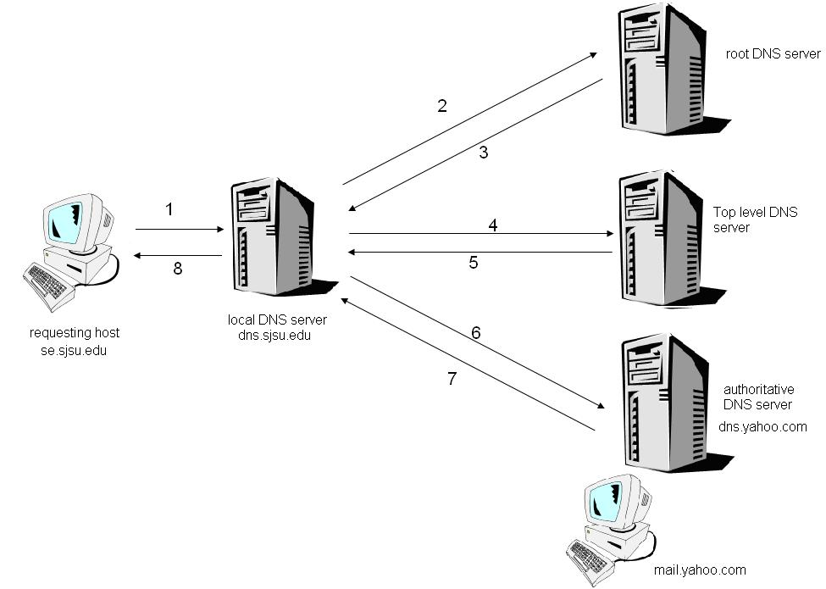
DOMAIN NAME SYSTEM (DNS)
DNS (domain name system
Host file
Wins
Lmhost file
DNS Resolution

Slide 40
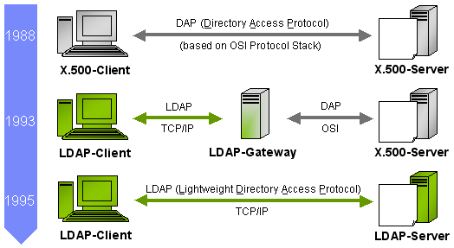
DIRECTORY SERVICES
A directory service is the collection of software and processes that store information about your enterprise, subscribers, or both.
CHARACTERISTICS:
1. Hierarchical Model
2. Shared Network Access
3. Extended Search Capability
4. Replicated Data.

Slide 41
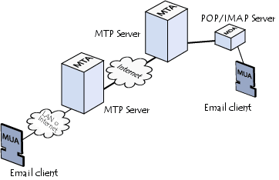
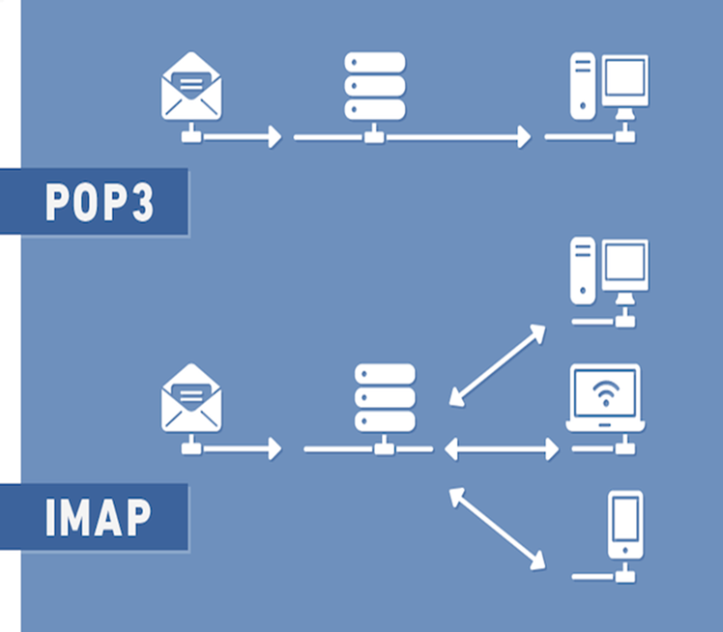
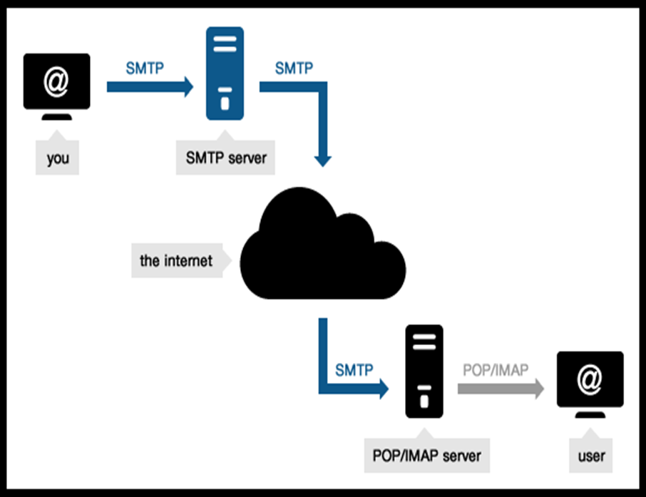
EMAIL SERVICES
Mail Transfer Agent(MTA)
Mail Delivery Agent(MDA)
Mail User Agent(MUA)
Notes:
Esta forma é legal e funciona bem aqui. A ponta pequena da forma verde tem que ser um pouco mais

Slide 42
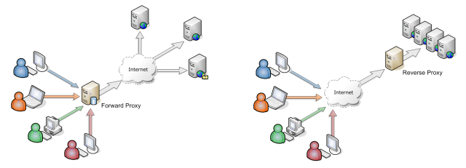
PROXY SERVICES
A proxy service is an intermediary role played by software or a dedicated computer system between an endpoint device and a client which is requesting the service.
The proxy service may exist on the same machine or on a separate server

Slide 43
DATABASE
FUNDAMENTALS

Slide 44
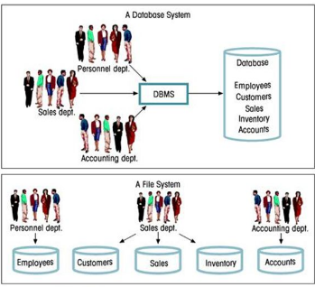
FILE SYSTEMS VS DATABASE
Data mapping
Data integrity
Data redundancy
Concurrent access anomalies
Limited data sharing

Slide 45
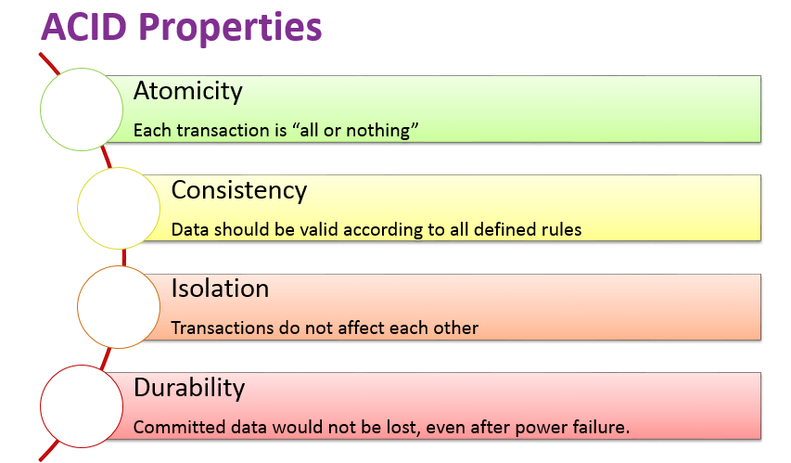
DATABASE FUNDAMENTALS
Terminologies
Constraints
Entity
Attribute
Domain
Degree
Cardinality
Tuple
Not Null
Unique
Default
Primary Key
Foreign Key
Check

Slide 46
NORMALIZATION
Why do we need normalization?
Anomalies in database
Update
Insert
Delete
Forms of normalization:
First normal form(1NF) - singled valued attribute.
Second normal form(2NF) - No Partial Dependency
Third normal form(3NF) - No transitive dependency
Boyce & Codd normal form (BCNF)

Slide 47
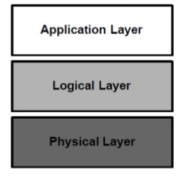
SQL
DATA TYPES
char
varchar
int
datetime
QUERIES
DDL - Create, Alter, Rename, Truncate, Drop
DCL - Insert, Delete, Update, Select
DML - Grant, Revoke
TCL - Commit, Rollback
General RDBMS Architecture

Slide 48
APPLICATION

Slide 49
APPLICATION PROGRAMMING INTERFACE
Components of an application
Life cycle of an application
Presentation logic
Business logic
Data persistence logic
Deployment
Performance tuning & Optimisation
Maintenance
Crash Recovery
Migration

Slide 50
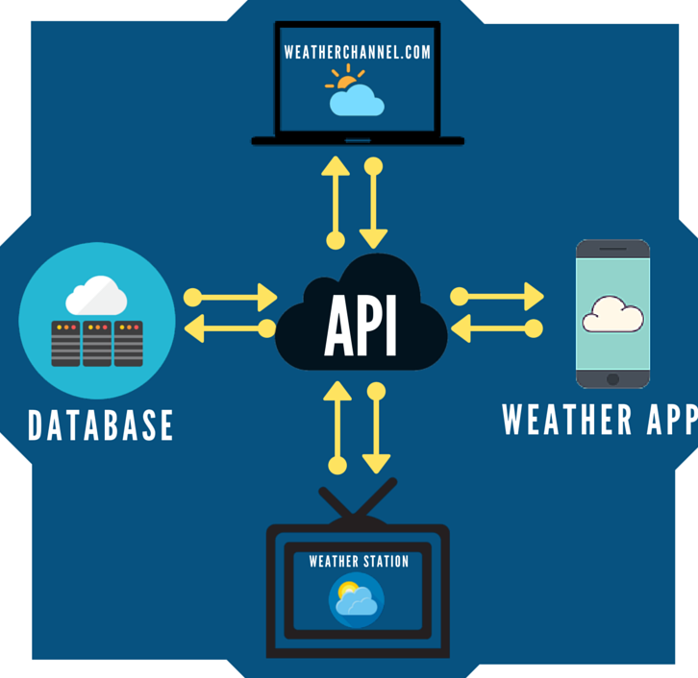
API
Types of application languages
Compiled
Interpreted
Application architecture types
Thick client architecture- Ex: Word
Thin client architecture- Ex: Gmail
Rich client architecture- Ex: YouTube

Slide 51
STORAGE FUNDAMENTALS

Slide 52
Storage Types
STORAGE FUNDAMENTALS
Direct attached Storage
Network Attached Storage
Storage Area Network

Slide 53
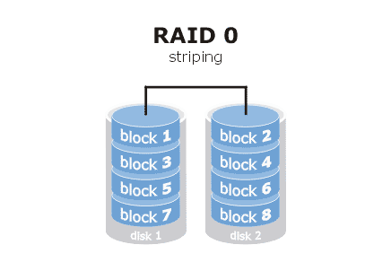
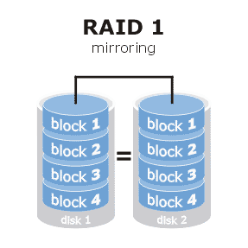
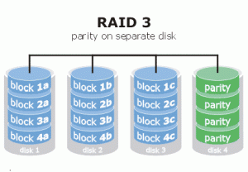
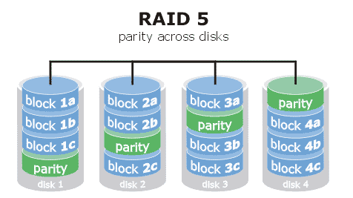
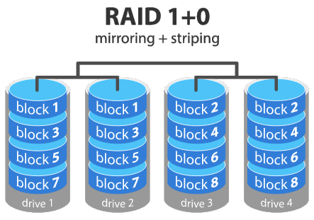
RAID

Slide 54
Essentials

Slide 55
Linux Essentials

Slide 56
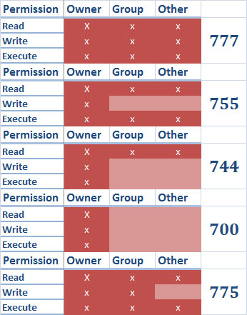
Permissions
User administration
Root user
System user
Normal user
Group administration
Primary
Secondary

Slide 57
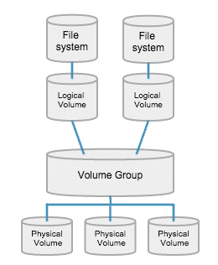
LVM
Partitioning
Create partition
Update to kernel
Create file system
Create mount point
Mounting – Temporary Permanent

Slide 58
Crontab
Table: Crontab Fields and Allowed Ranges (Linux Crontab Syntax)
Field | Description | Allowed Value
MIN | Minute field | 0 to 59
HOUR | Hour field | 0 to 23
DOM | Day of Month | 1-31
MON | Month field | 1-12
DOW | Day Of Week | 0-6
CMD | Command | Any command to be executed.

Slide 59
Windows Essentials

Slide 60
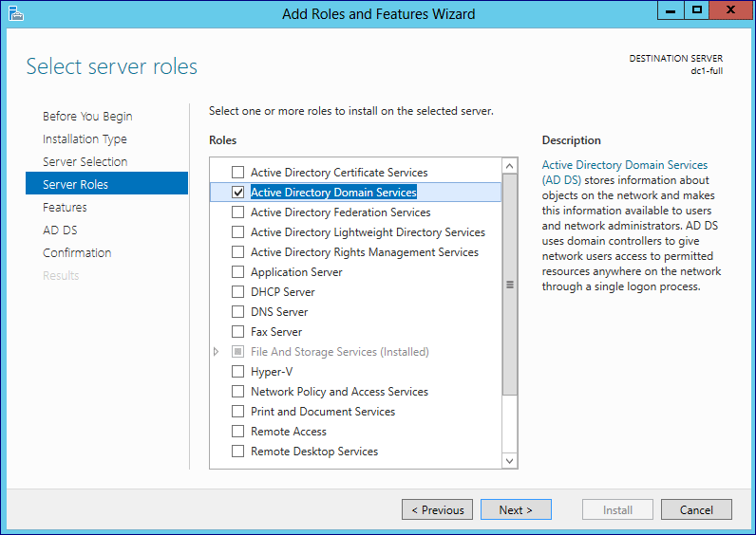
Active Directory Domain Services
Microsoft Active Directory Domain Services are the foundation for distributed networks.
Active Directory Domain Services provide secure, structured, hierarchical data storage for objects in a network such as users, computers, printers, and services.

Slide 61
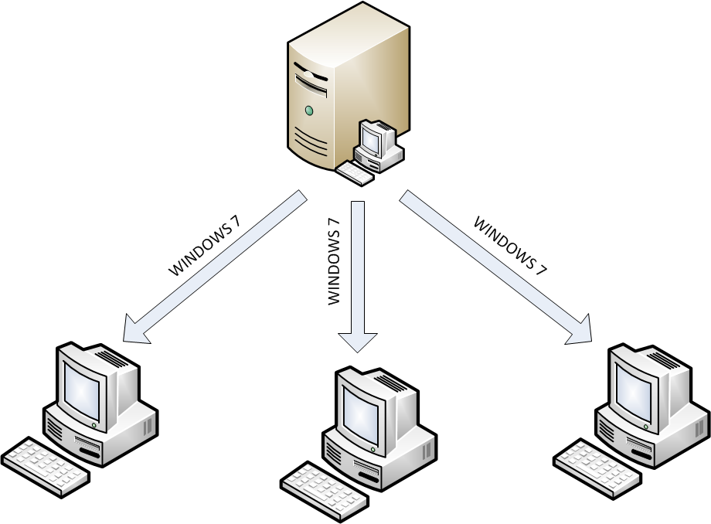
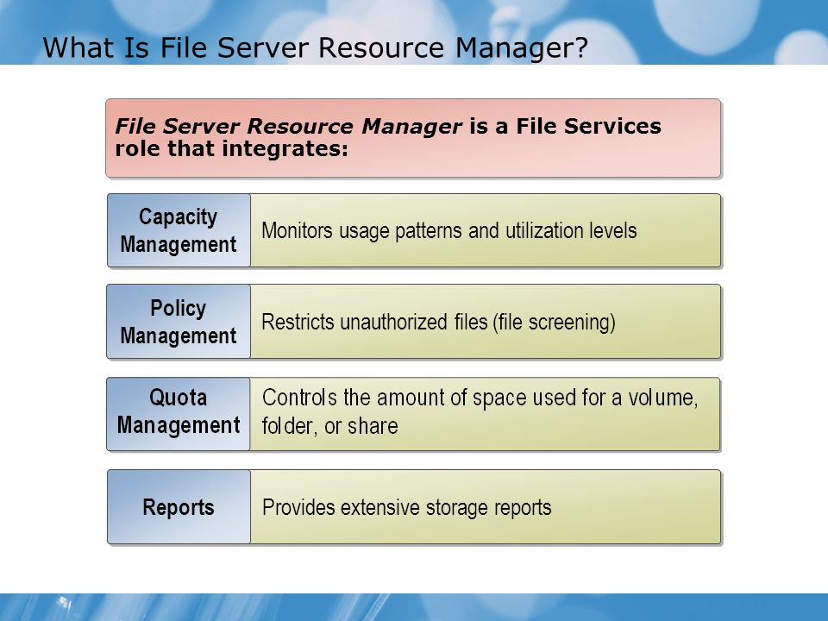
Windows Deployment Services
File Server Resource Management

Slide 62
Cisco Routing

Slide 63
Routing Protocols
 | RIP | OSPF | EIGRP
Scale | Small networks | Enterprise network | medium
Metrics | Number of Hopes | Cost | Bandwidth and delay
Convergency rate | 30 | 10 | 5

Slide 64


VLAN and VTP

Slide 65
Virtualization

Slide 66


What is virtualization?

Slide 67


High availability
Load Balancing

Slide 68
THANK YOU

